Slide 1
COVID 19 Exploratory Data Analysis Project
Mentor:
Ramakanta Chowdhuri

Slide 2
ACKNOWLEDGEMENT
I take this opportunity to express my profound gratitude and deep regards to my faculty Data Analysis Mentor for his exemplary guidance, monitoring and constant encouragement throughout the course of this project. The blessing, help and guidance given by him shall carry me a long way in the journey of life on which I am about to embark.
I am obliged to my project team members for the valuable information provided by them in their respective fields. I am grateful for their cooperation during the period of my assignment.

Slide 3
TABLE OF CONTENTS
01
02
03
04
SECTION
SECTION
SECTION
SECTION
05
06
07
08
SECTION
SECTION
SECTION
SECTION
Introduction
Project Objective and scope
Workflow
Data Description
Correlation Matrix
Heat Maps
Graph Presentation
Future Scope

Slide 4
INTRODUCTION
The COVID-19 pandemic has undoubtedly been one of the most significant global challenges of our time, impacting every aspect of society and posing unprecedented challenges to healthcare systems worldwide. In our endeavor to understand and mitigate the effects of this pandemic, data analysis has emerged as a crucial tool for gaining insights into the spread, impact, and response to the virus.
In this report, we present the findings of our exploratory data analysis (EDA) conducted on COVID-19 data. Our analysis focuses on understanding various aspects of the pandemic using real-world data, aiming to provide insights that can aid in informed decision-making and effective strategies for combating the spread of the virus.

Slide 5
PROJECT OBJECTIVE AND SCOPE
Objective:
Conduct exploratory data analysis (EDA) on COVID-19 data.
Utilize data visualization techniques and statistical analysis.
Extract insights into the spread and impact of the virus.
Scope:
Data Collection & Preprocessing: Collect real-world COVID-19 data, preprocess for integrity.
Descriptive Statistics: Provide overview, summary statistics, key metrics.
Data Cleaning & Transformation: Address inconsistencies, fill missing values, remove outliers.
Data Visualization: Use various techniques to uncover trends, patterns, correlations.
Key Findings & Insights: Identify trends, patterns, insights into the pandemic dynamics.
Limitations: Acknowledge biases, dataset limitations, uncertainties.

Slide 6
WORKFLOW
We began our analysis by importing and preprocessing the dataset, ensuring data integrity and consistency. Subsequently, we conducted descriptive statistics to gain a holistic understanding of the dataset's characteristics, including summary statistics and data distribution.
Furthermore, we performed data cleaning procedures to address missing values and irrelevant columns, ensuring the reliability and accuracy of our analysis. Additionally, we utilized data visualization techniques such as bar plots, pie charts, line plots, and scatter plots to visually represent key findings and trends within the data.

Slide 7
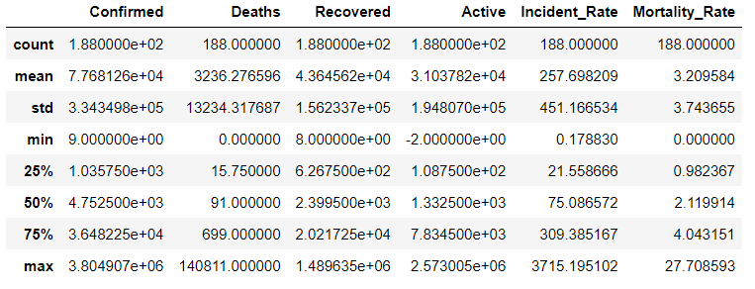
DATA DESCRIPTION
Data Description provides a statistical summary of the dataset. It includes:
Mean: Average value.
Std Dev:
Data dispersion from mean.
Min & Max: Range of values.
25th, 50th (Median), & 75th Pctl: Quartiles showing data distribution.
Count: Non-null values count.
Using this, we can gain insight and understanding of the following:
Confirmed Cases: Average number.
Deaths & Recoveries: Range of values. Incidence Rate & Mortality Rate: Variation across regions.
Implications: Understanding data distribution. Identifying outliers or unusual patterns.

Slide 8
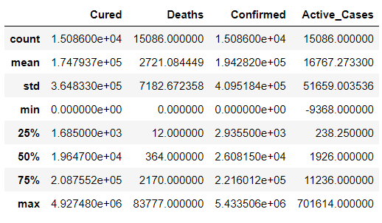
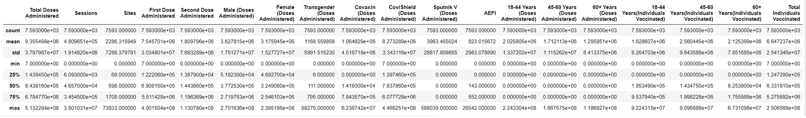
DATA DESCRIPTION
Here we see the data description of the COVID-19 India Statewise dataset.
Using this, we can gain insight and understanding of the following:
Confirmed Cases: Average number.
Deaths & Active Cases: Range of values.
Cured Cases: How much was the final total count
And so on
Here we see the data description of the COVID-19 India Statewise Vaccination dataset.

Slide 9
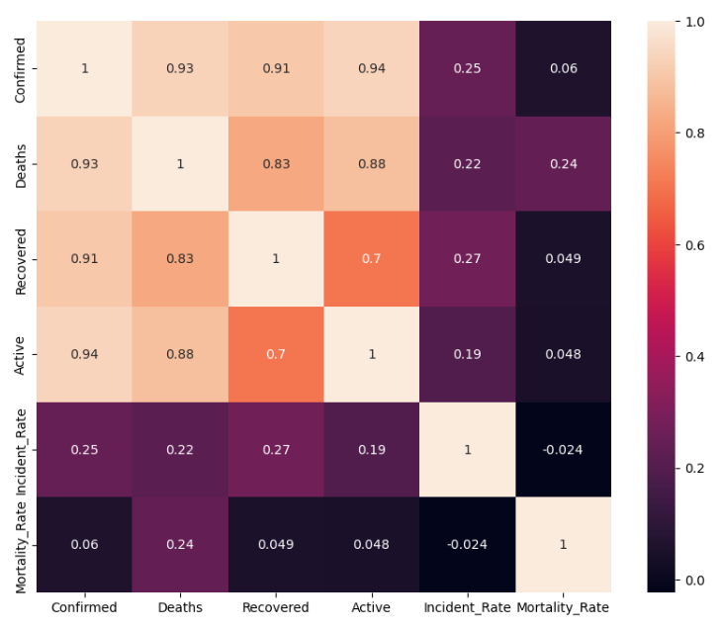
CORRELATION MATRIX
Correlation Matrix are used to explore the relationships between COVID-19 metrics.
In this dataset, we analysed the metrics: Confirmed cases, deaths, recoveries, active cases, incidence rate, and mortality rate.
In a Correlation Matrix, positive values (closer to 1) indicate positive correlations, negative values (closer to -1) imply negative correlations, and values near 0 suggest weak or no correlation.

Slide 10
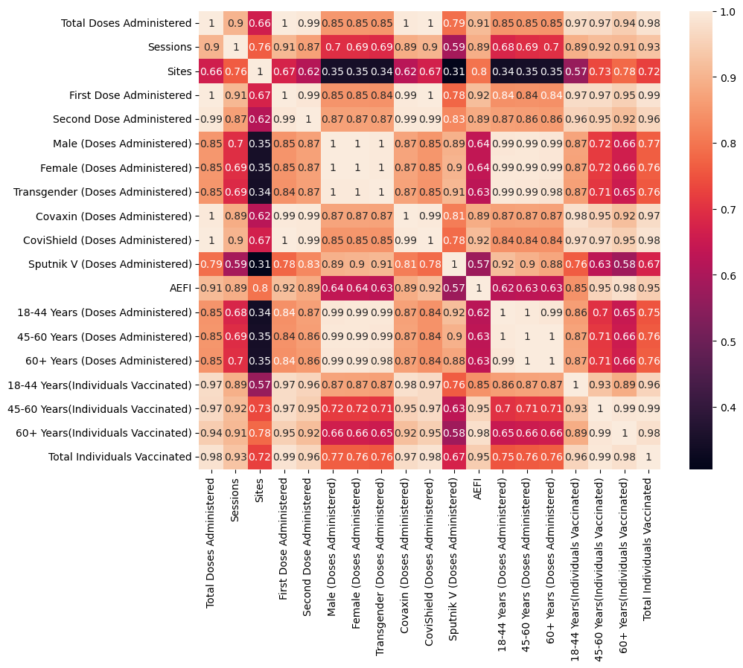
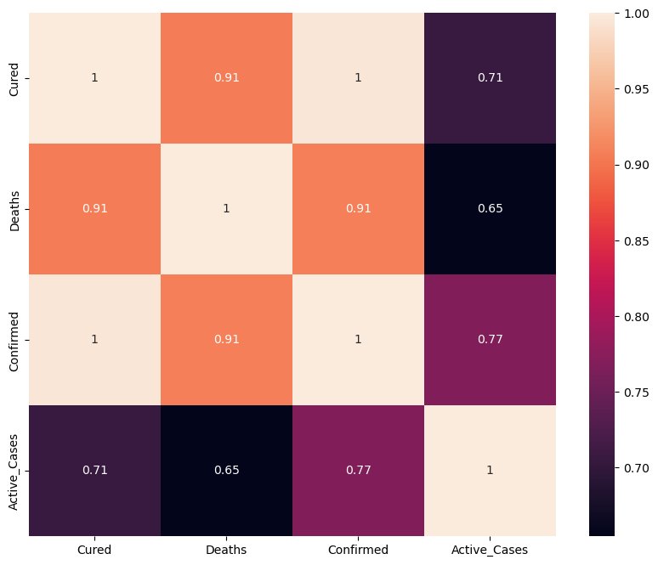
CORRELATION MATRIX
Correlation Matrix of COVID 19 India Statewise Dataset
Correlation Matrix of COVID 19 India Statewise Vaccination Dataset

Slide 11
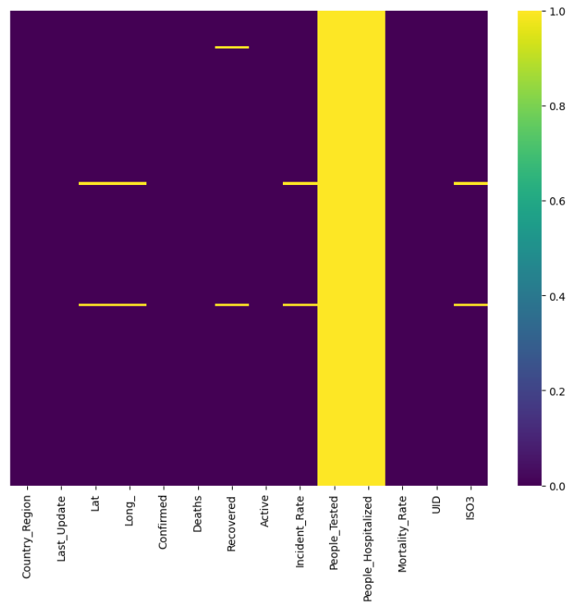
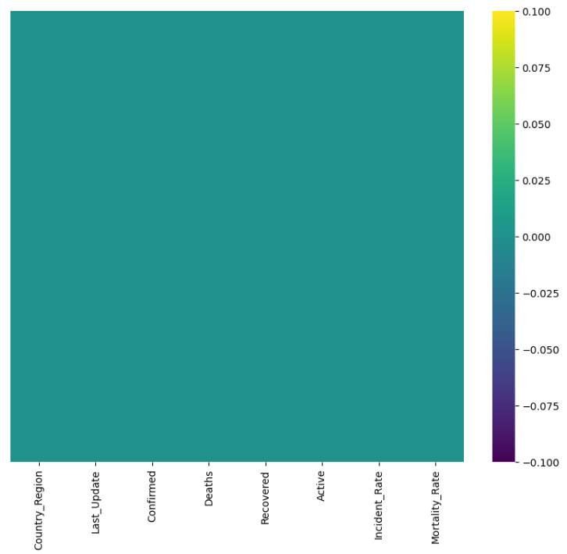
HEAT MAP
Below we have Heat Maps representing the Null values in the dataset, before and after preprocessing them:
The yellow in this heatmap represents all the null values, while the violet represents all filled values
After preprocessing is done, all Null values are either filled or removed.

Slide 12
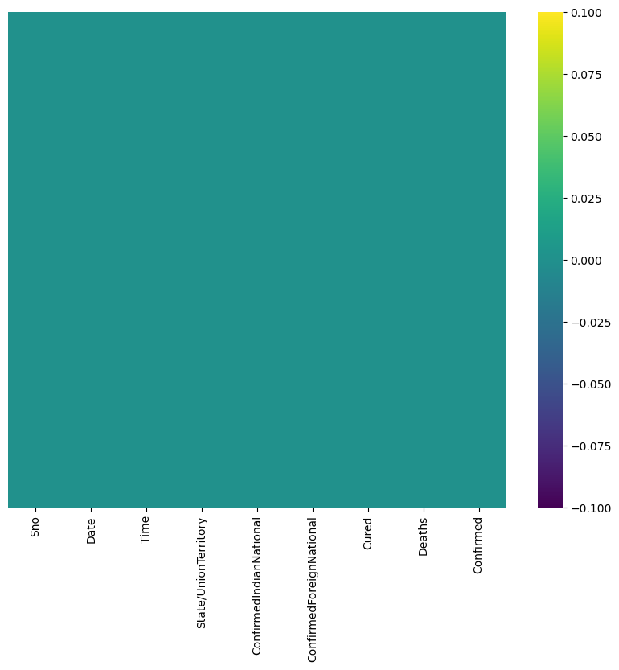
HEAT MAP
Here we have Heat Maps representing the Null values in the COVID 19 India Statewise dataset.
This dataset had no null values hence it only has one heat map.
This made it easier to analyse and visualize the dataset

Slide 13
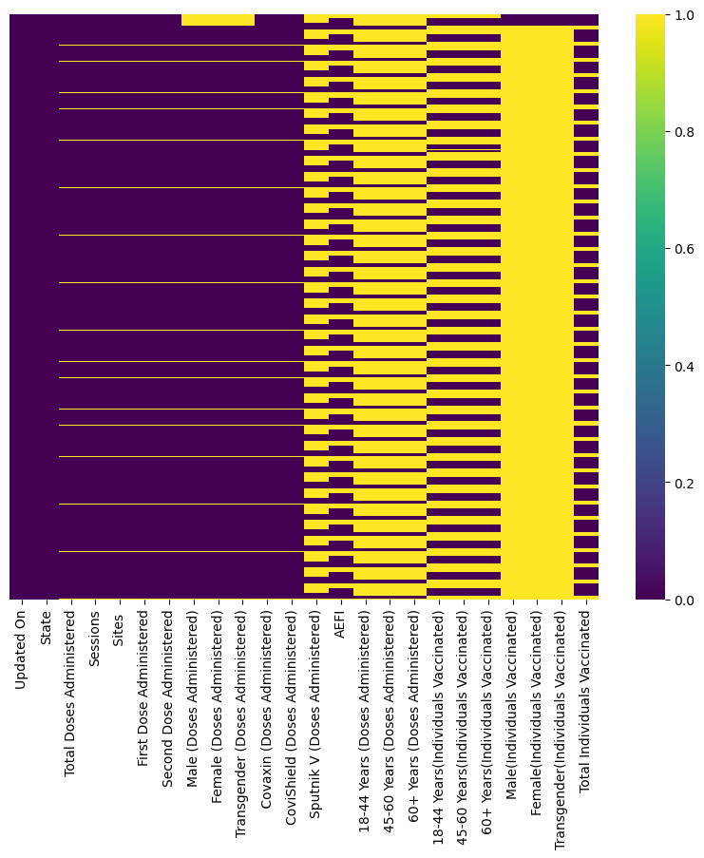
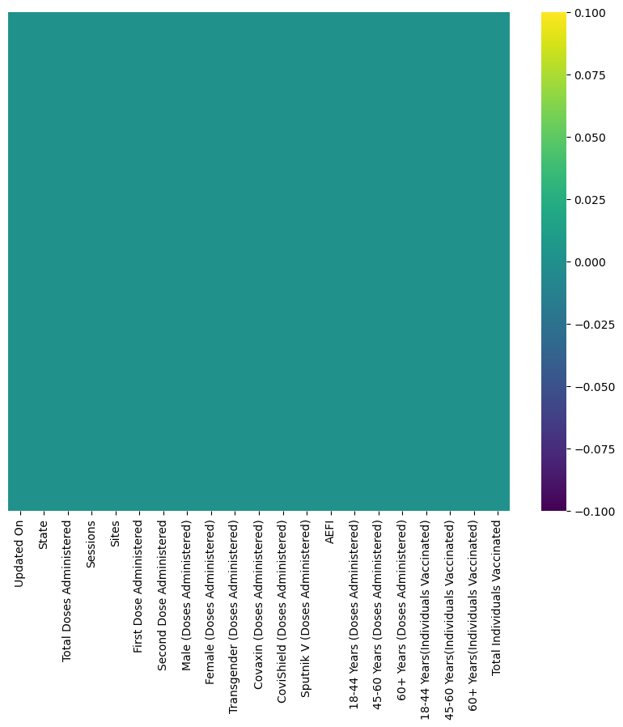
HEAT MAP
Below we have Heat Maps representing the Null values in the COVID 19 India Statewise Vaccination dataset, before and after preprocessing them:
The yellow in this heatmap represents all the null values, while the violet represents all filled values
After preprocessing is done, all Null values are either filled or removed.

Slide 14
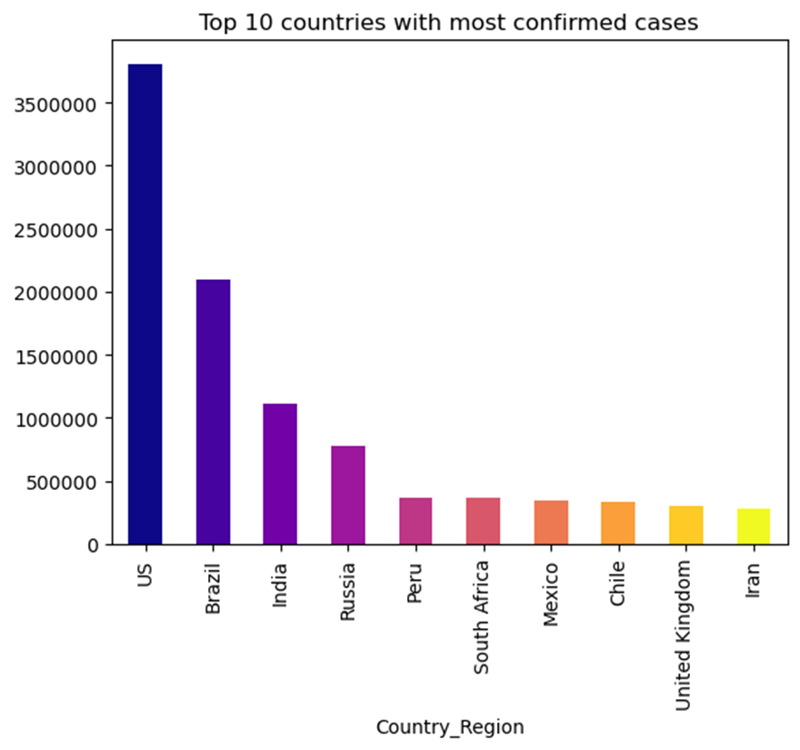
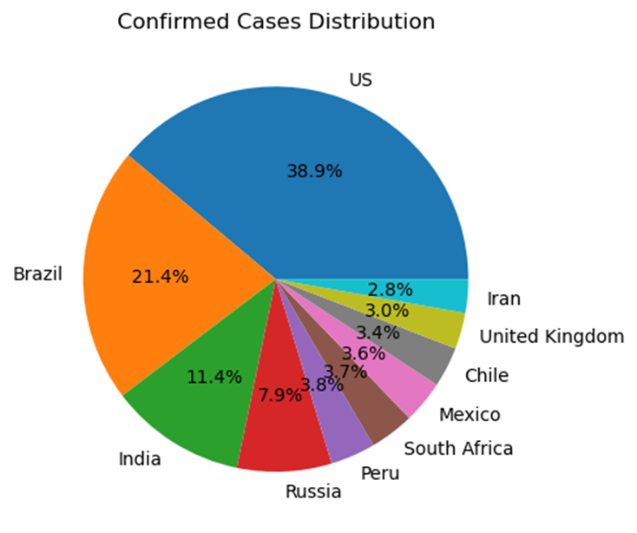
GRAPHICAL REPRESENTATION
First, we will have a look at the COVID -19 worldwide dataset:
Observing the data when graphed, we see that the top 10 countries with most confirmed cases were:
US
Brazil
India
Russia
Peru
South Africa
Mexico
CHile
UK
Iran
With US have reported the most number of confirmed cases, taking almost 40% within the top 10 itself.

Slide 15
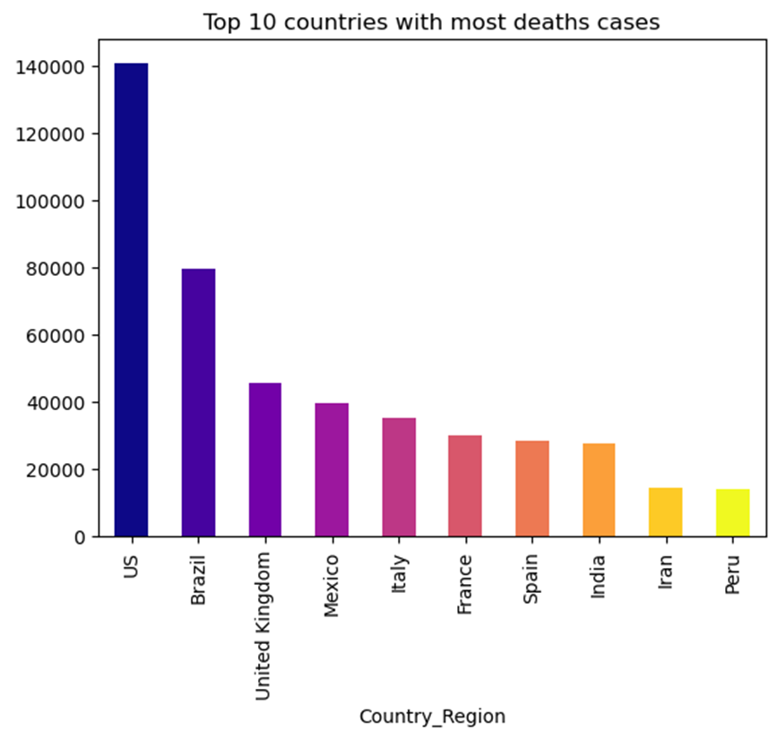
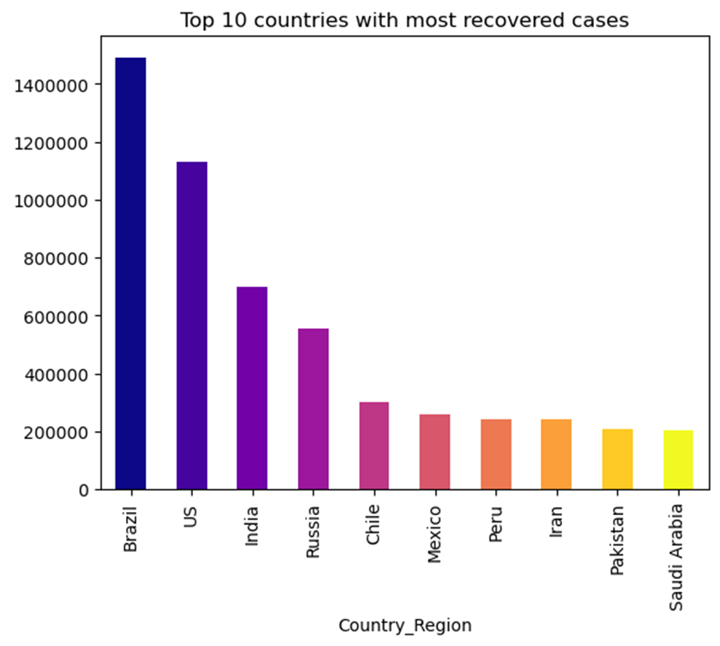
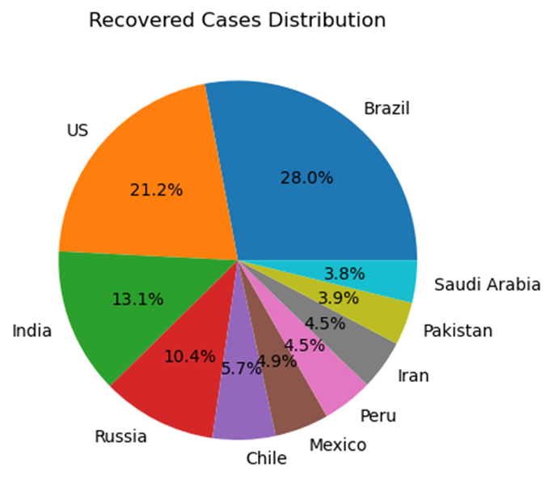
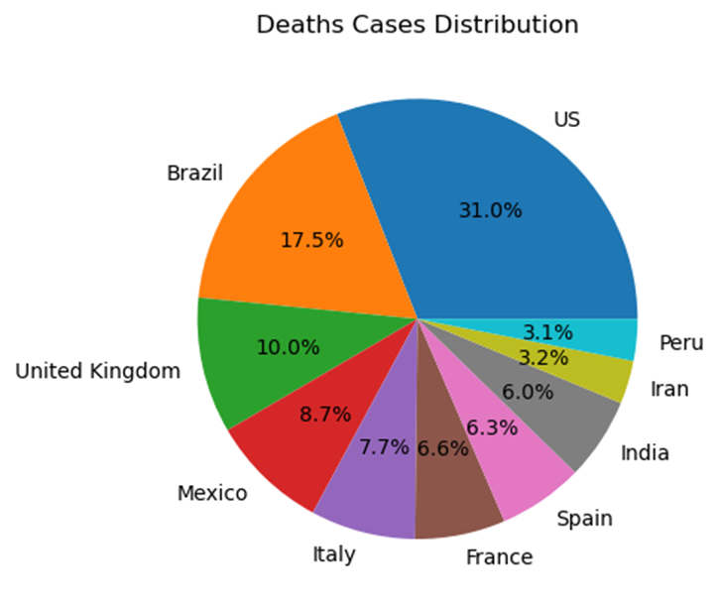
GRAPHICAL REPRESENTATION
Comparing with the numbers for death cases and, we see US has higher number of death cases.
However, Brazil has more number of recovered cases in contrast to the number of confirmed cases.
This visualization allows us to better understand the incidents that happened in these countries.

Slide 16
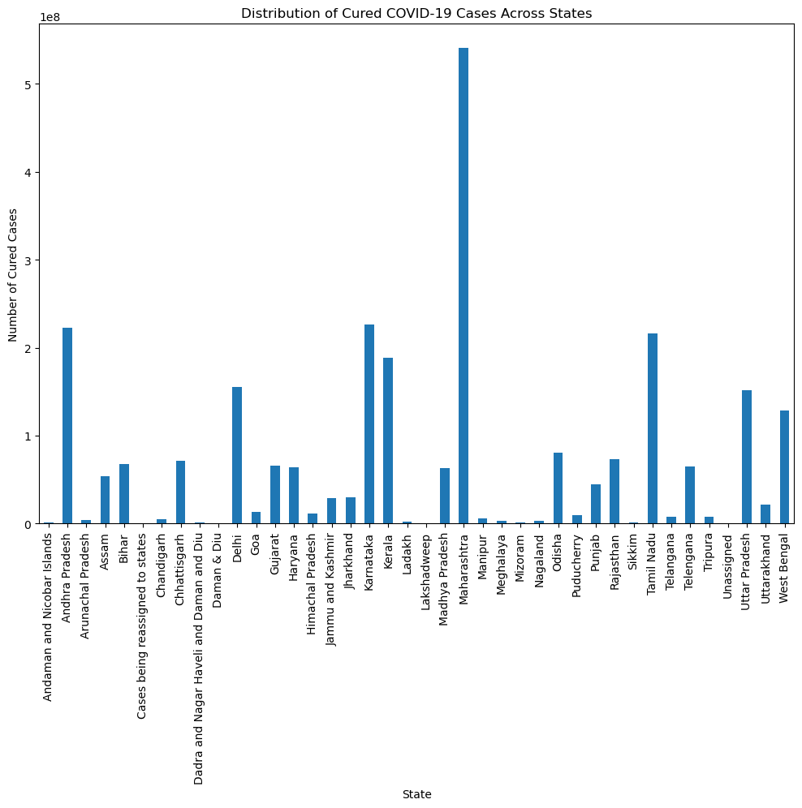
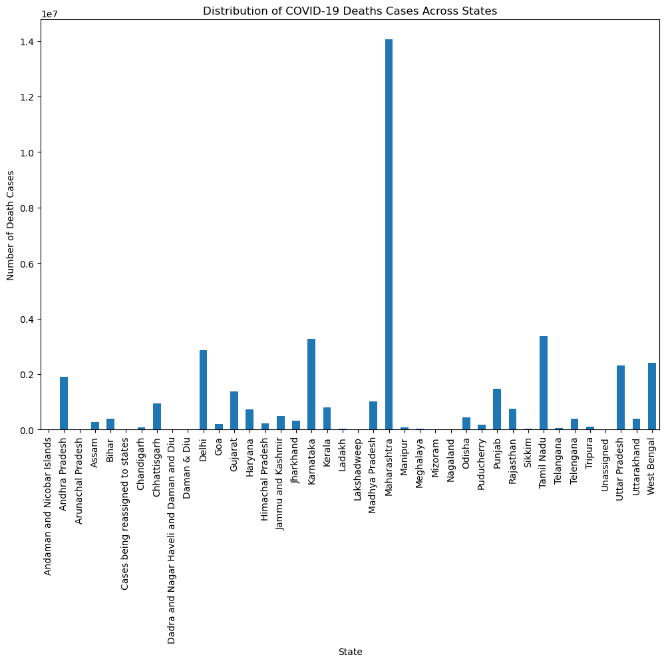
GRAPHICAL REPRESENTATION
Below, we compare the distribution of Cured and Death Cases across the different states of India.

Slide 17

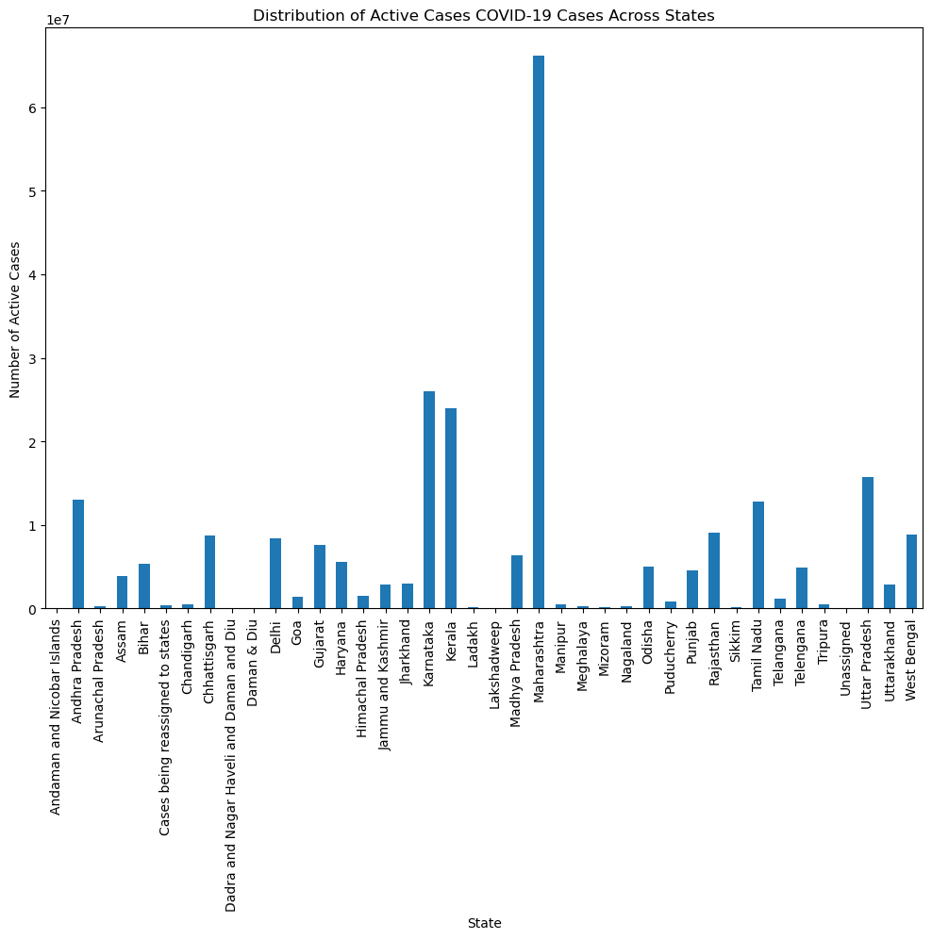
GRAPHICAL REPRESENTATION
And here we see the distribution of Confirmed and Active Cases across the different states of India.

Slide 18
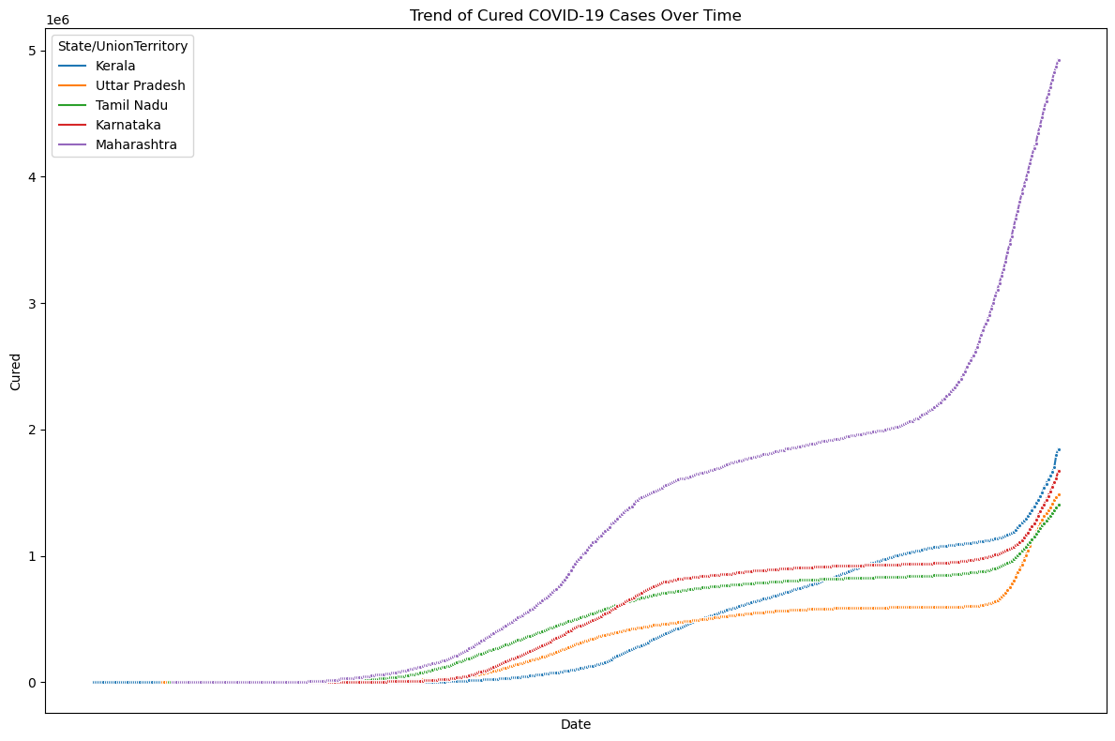
GRAPHICAL REPRESENTATION
Using the previous graphs we determine the States that show the largest values of Cured cases across India.
We then take the top 5 states and plot a graph to better visualize the change in reported numbers over a duration.

Slide 19
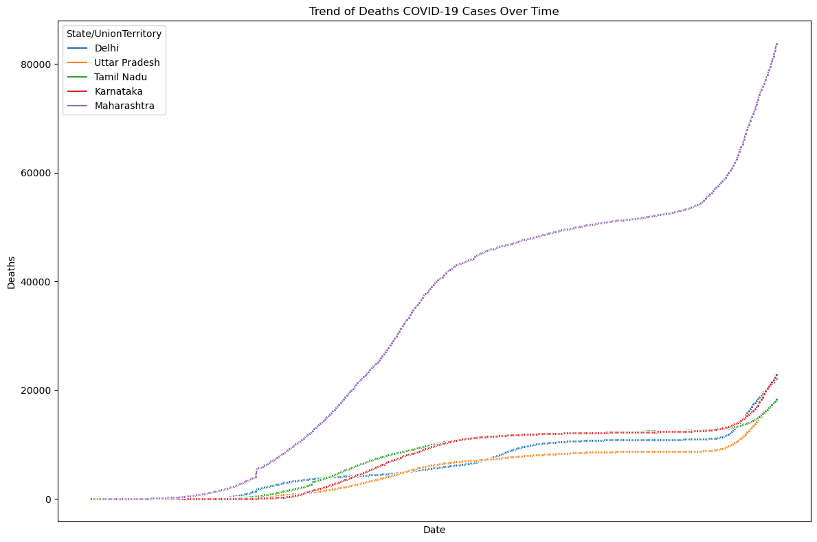
GRAPHICAL REPRESENTATION
We do the same for the Death cases across 5 states with the most reported death cases over a duration.

Slide 20
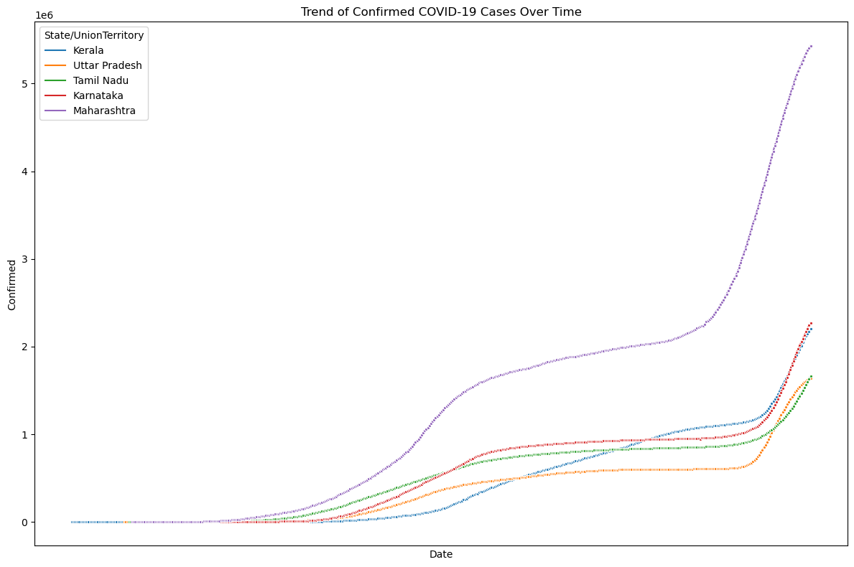
GRAPHICAL REPRESENTATION
We do the same for the Confirmed cases across 5 states with the most number of reported Confirmed cases.
This allows us to see how the number of reported cases was on the rise over time.

Slide 21
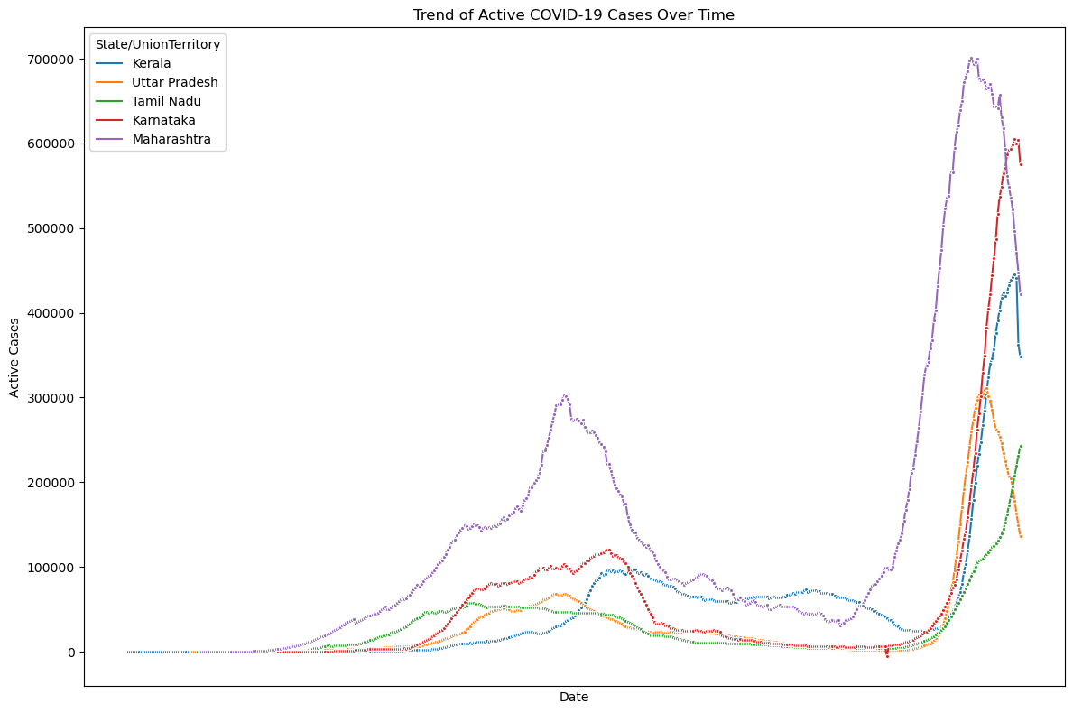
GRAPHICAL REPRESENTATION
We do the same for the Active cases across 5 states with the most reported active cases over a duration.

Slide 22
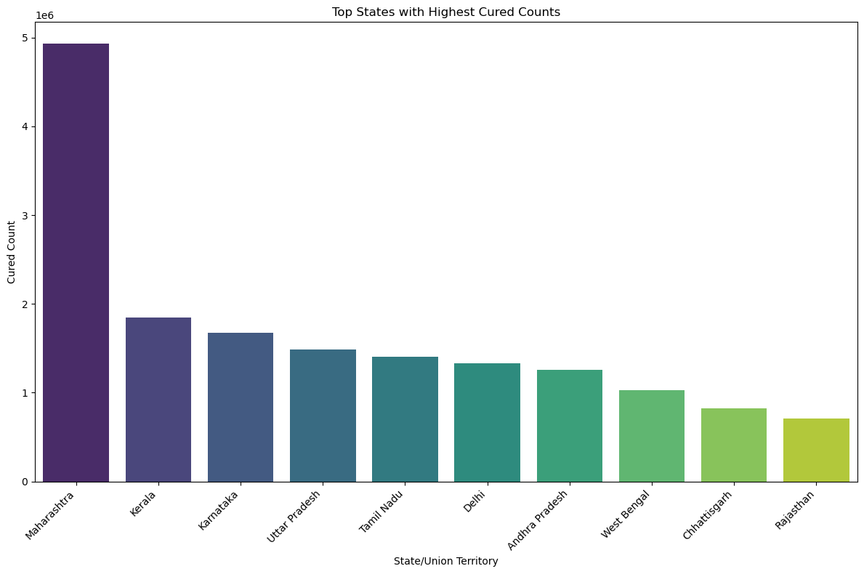
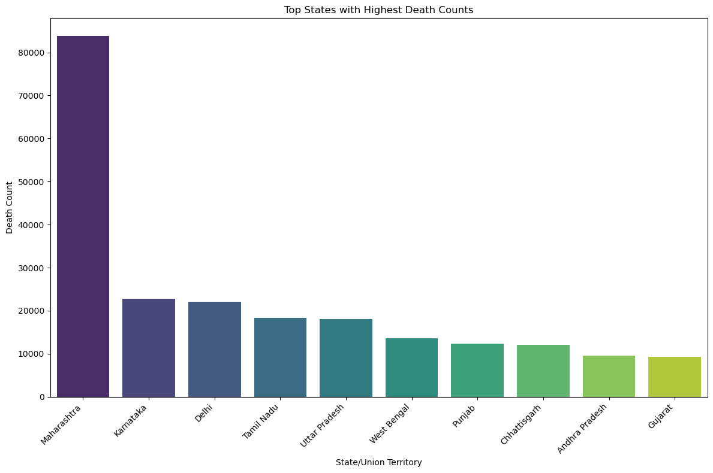
GRAPHICAL REPRESENTATION
To get a clearer view we plot the top 10 states with the highest number of Cured and Death cases to better put it into perspective.

Slide 23
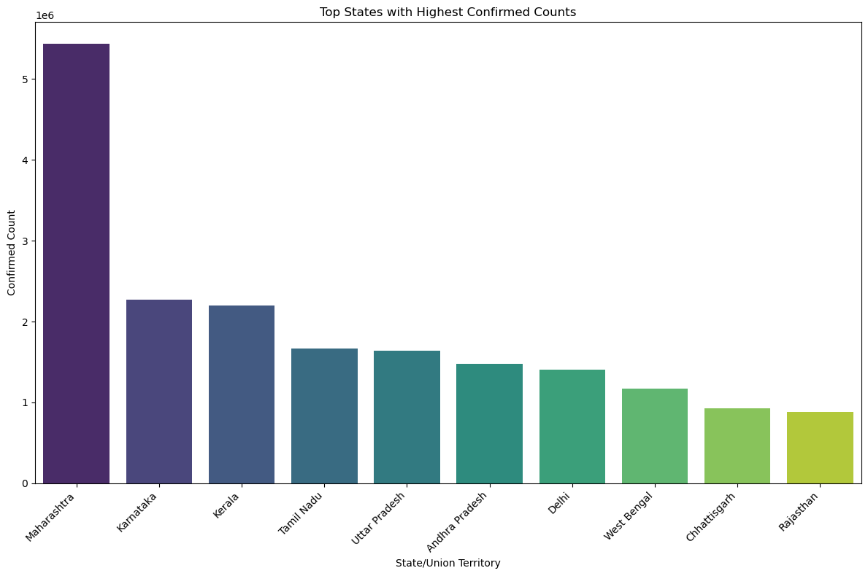
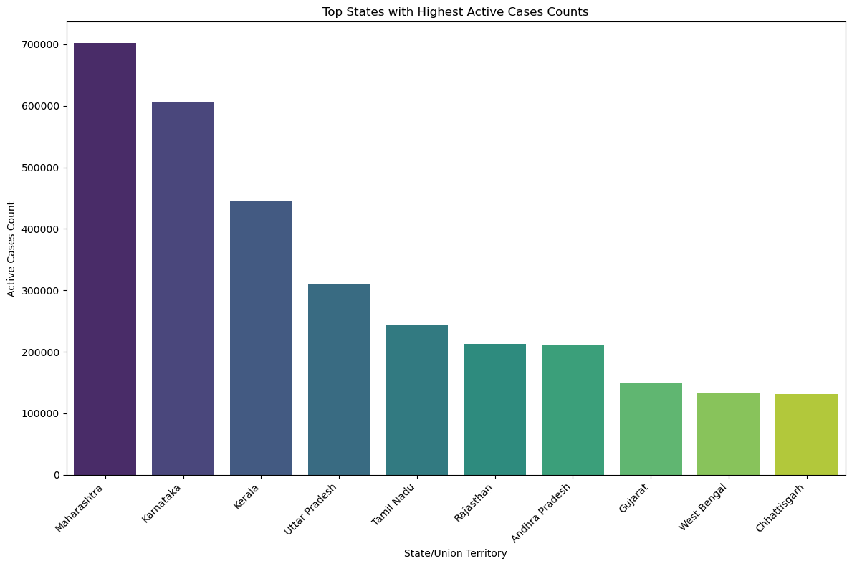
GRAPHICAL REPRESENTATION
To get a clearer view we plot the top 10 states with the highest number of Cured and Death cases to better put it into perspective.

Slide 24
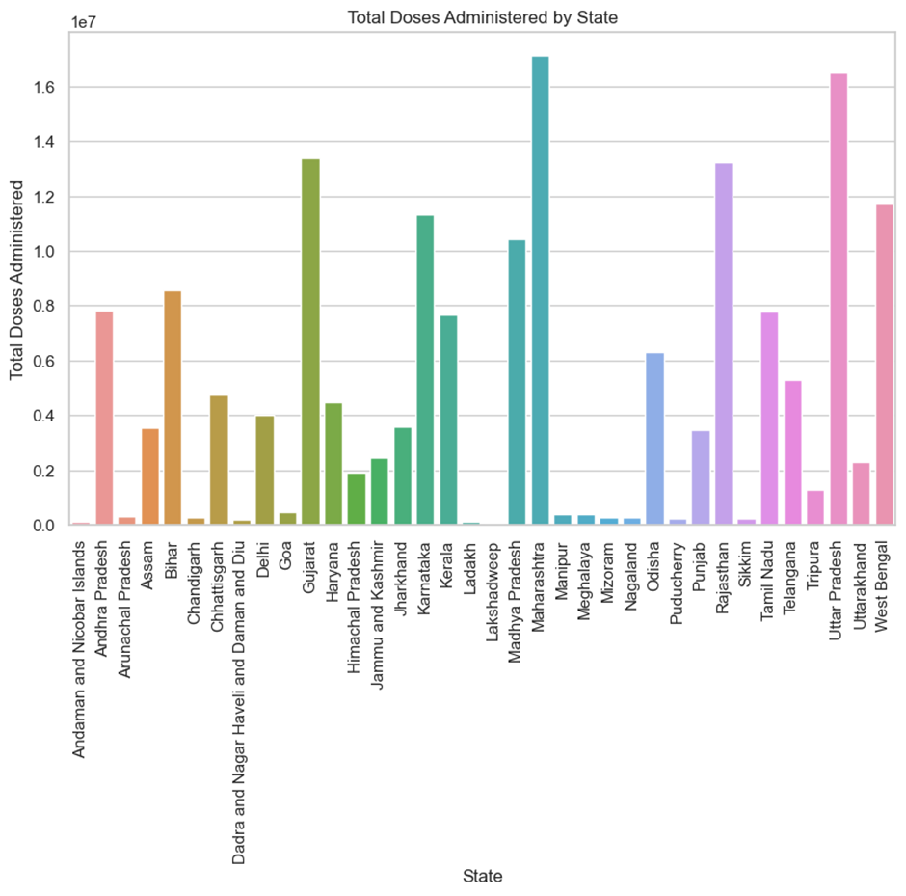
GRAPHICAL REPRESENTATION
Here we plot the total vaccination doses administered across the different states of India.
This allows us to better understand where more vaccine doses were administered, allowing us to better understand and realise the areas prioritised.

Slide 25
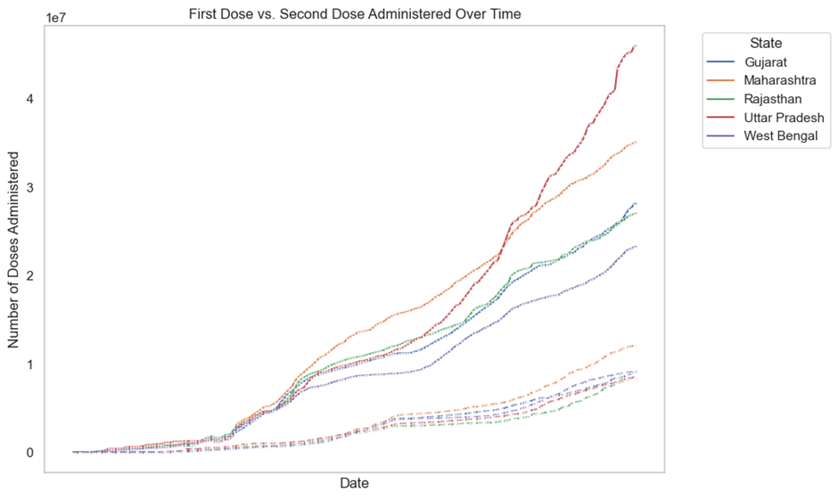
GRAPHICAL REPRESENTATION
Here we plot the difference between the number of first dose administered and the number of second dose administered across the top 5 states with the highest number of doses administered over a set period of time.

Slide 26
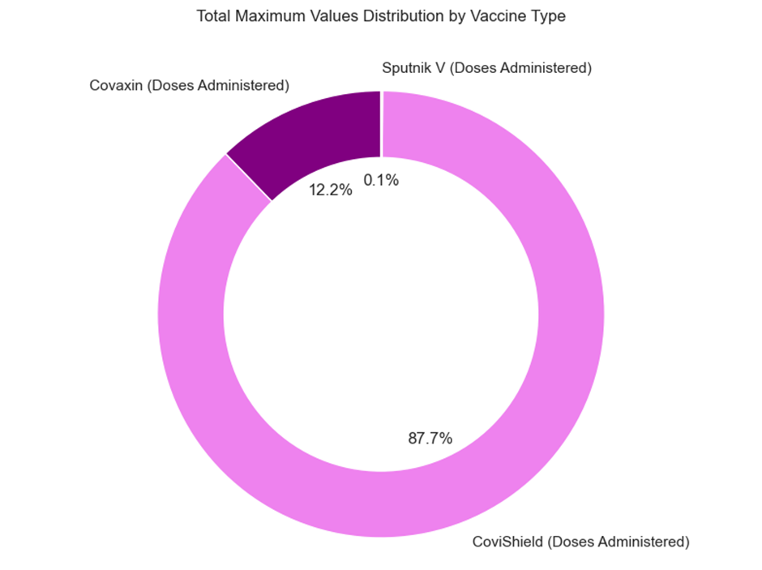
GRAPHICAL REPRESENTATION
Here we visualize the different vaccines that were distributed.
This lets us see which vaccine was most used during the pandemic, as well as giving a percentage of how much these vaccines were used across the states.

Slide 27
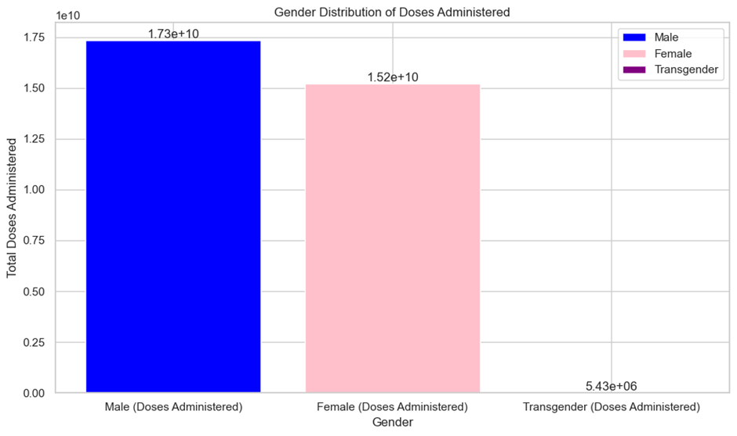
GRAPHICAL REPRESENTATION
Here we visualize doses administered to the different genders.
This gives a clear visual on the majority and minority of the population that received a vaccination dose based on gender.

Slide 28
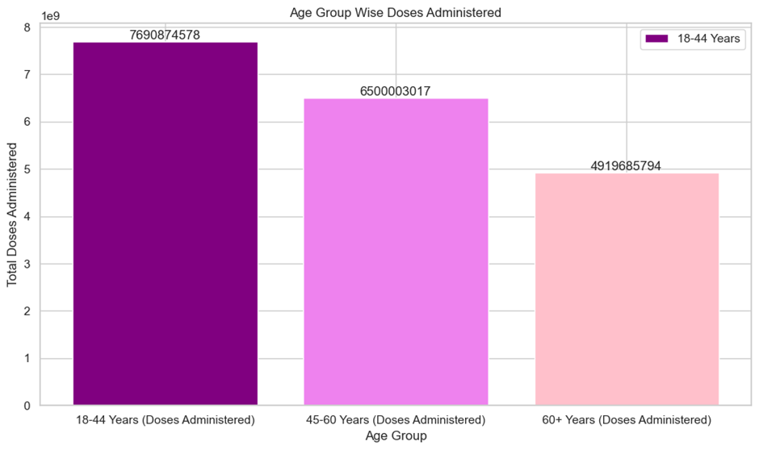
GRAPHICAL REPRESENTATION
Here we visualize the data similar to the previous slide, however we graph the data based on age groups instead.

Slide 29
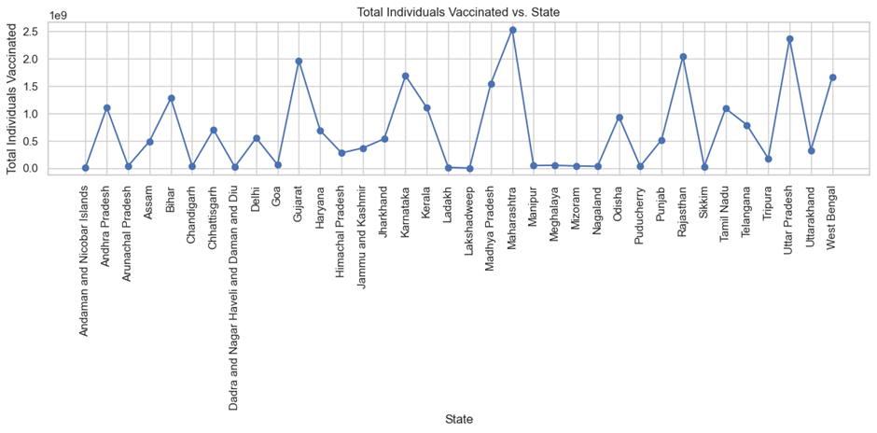
GRAPHICAL REPRESENTATION
Here we have plotted a graph representing the total number of individuals vaccinated across all the different states.

Slide 30
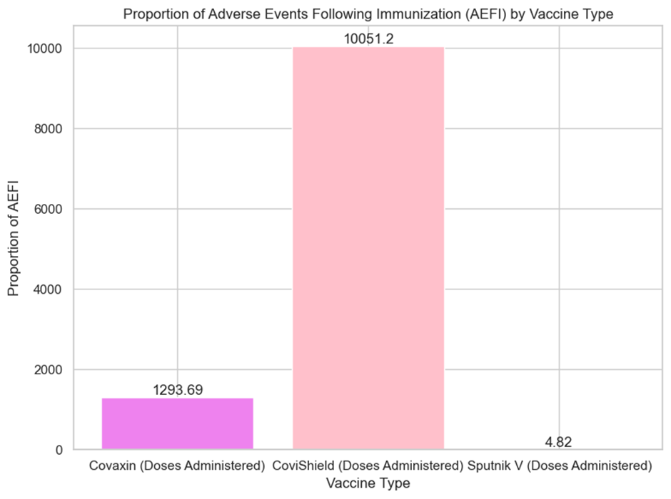
GRAPHICAL REPRESENTATION
AEFI stands for Adverse Events Following Immunization. It refers to any untoward medical occurrence that happens after someone receives a vaccine but is not necessarily caused by the vaccine itself. These events can range from mild reactions like pain or swelling at the injection site to more serious conditions, although severe adverse events following immunization are rare.
Therefore it is important to record whenever it happened to better study and under the causes.
Here we plot the recorded AEFI incidents that occured after administering the different vaccines

Slide 31
FUTURE SCOPE
There are several things we can improve on for this project to be even more informative and helpful, some of which include:
Predictive Modeling: Develop models to forecast COVID-19 trends.
Geospatial Analysis: Analyze regional variations in transmission rates.
Machine Learning: Identify patterns influencing virus spread.
Sentiment Analysis: Gauge public perceptions and concerns.
Epidemiological Studies: Collaborate on disease dynamics research.
Longitudinal Analysis: Track evolving trends over time.
Data Integration: Include vaccination rates and mobility data.
Interactive Dashboards: Provide real-time updates and insights.
Collaborative Research: Partner with public health organizations.
Ethical Considerations: Address data privacy and bias mitigation.

Slide 32
THANKS!
THANKS!

